Slide 1
Timeseries Forecast App
Hanu Sravanth T

Slide 2
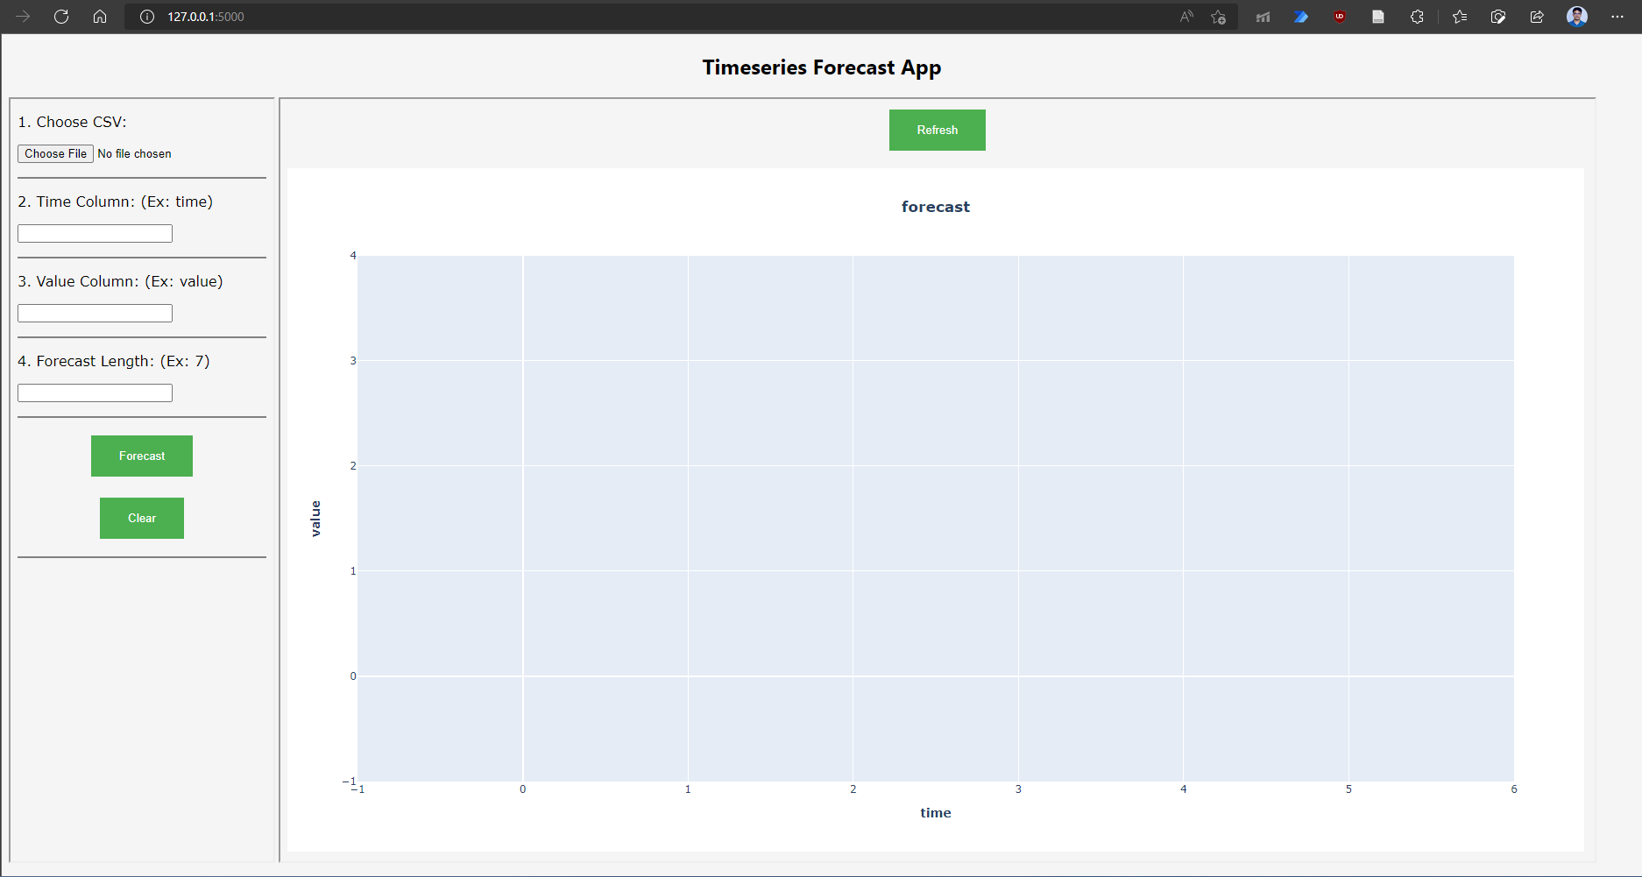

Slide 3
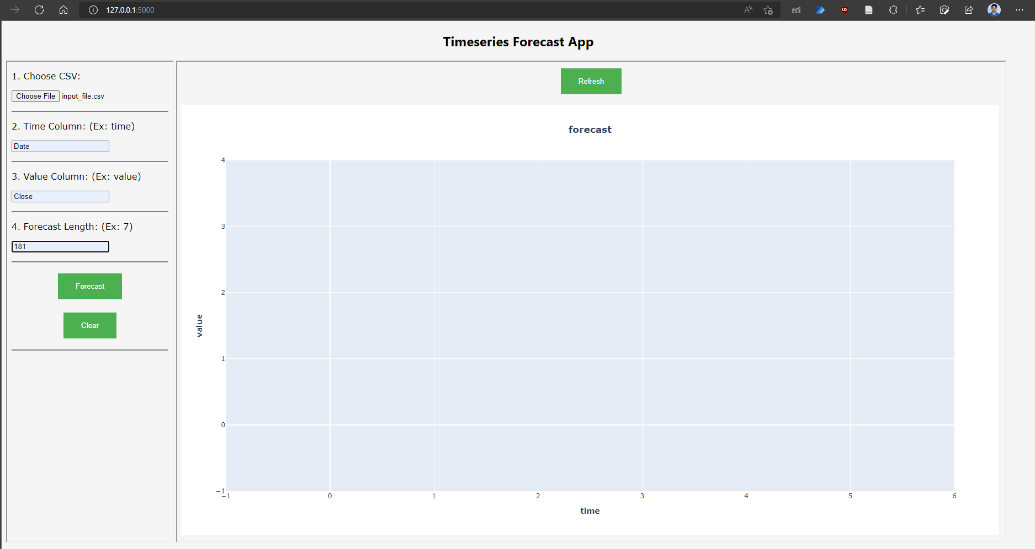

Slide 4
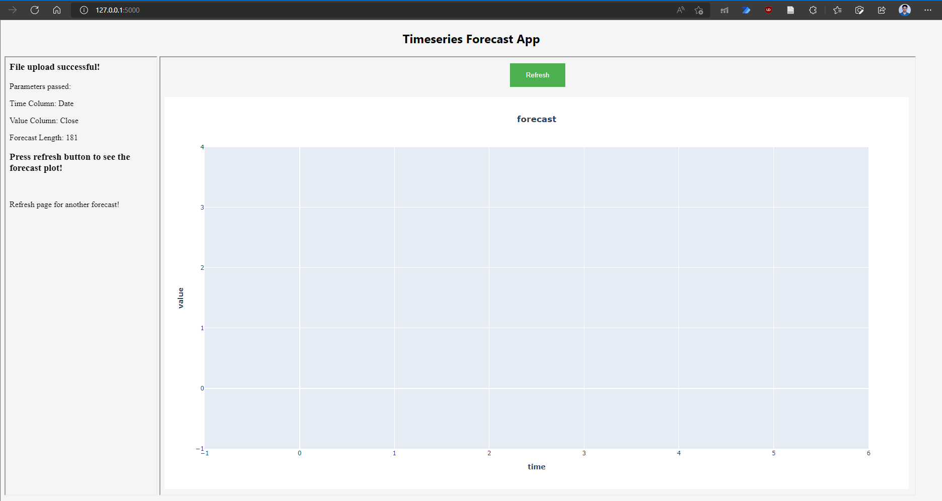

Slide 5
